Slide 1
Stacking

Slide 2
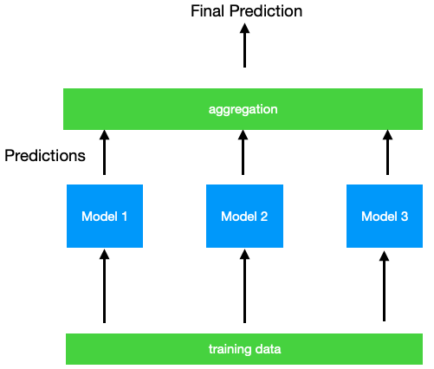
Stacking
Training several models, aggregating predictions (mode, mean)

Slide 3
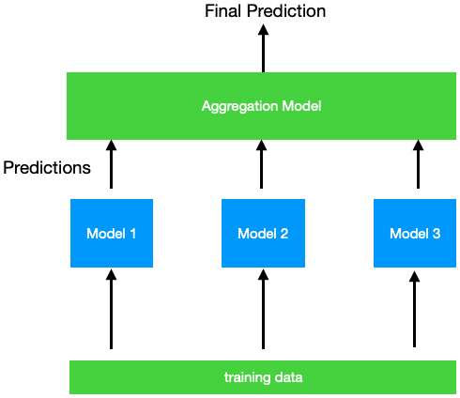
Stacking
Training several models, aggregating predictions (mode, mean)
Replace simple aggregation with model to perform aggregation

Slide 4
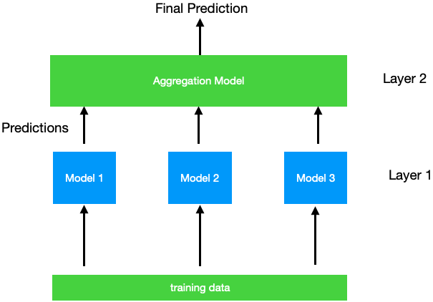
Data Splitting - Blending
Split training set into training and holdout set
Layer 1 is trained on training set
Layer 2 is trained on holdout set
Predictions are made on holdout set output from the trained models from layer 1

Slide 5
Data Splitting - Blending
Split training set into training and holdout set
Layer 1 is trained on training set
Layer 2 is trained on holdout set
This is called blending, and final agg. model is called blender

Slide 6
Data Splitting - Blending
Split training set into training and holdout set
Layer 1 is trained on training set
Layer 2 is trained on holdout set
This is called blending, and final agg. model is called blender
Layer predictions are made sequentially (layer 1 -> layer 2)

Slide 7
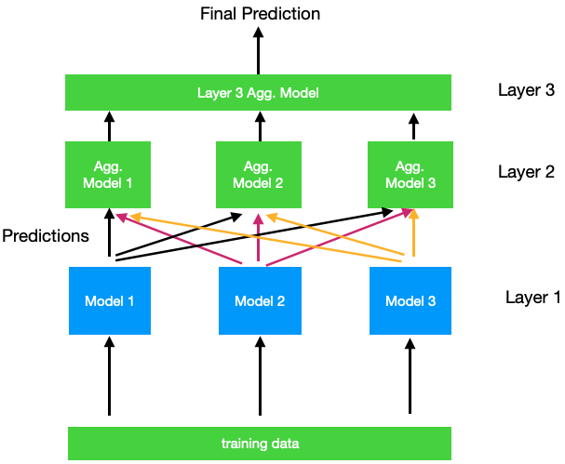
Extra layers
Can add additional aggregation layers
Data now needs to be split into 3 sets, instead of 2
Higher number of layers require more data splits

Slide 8
Considerations
Can be a better approach than simple aggregations
Higher computation times (training and prediction)

